Slide 1
Employee Data Analysis using Excel
STUDENT NAME: V.ARCHANA
REGISTER NO: 422200468
DEPARTMENT: III B.COM(ISM)
COLLEGE: VALLIAMMAL COLLEGE FOR WOMEN

Slide 2
PROJECT TITLE
Employee Performance Analysis using Excel

Slide 3

AGENDA
Problem Statement
Project Overview
End Users
Our Solution and Proposition
Dataset Description
Modelling Approach
Results and Discussion
Conclusion
3/21/2024 Annual Review

Slide 4

PROBLEM STATEMENT
Salary analysis refers to the process of examining
and evaluating an organization’s salary structure
and compensation practices. Salary analysis helps
organisations ensure that their compensation
practices are fair, competitive, and aligned with
both employee expectations and market
conditions

Slide 5

PROJECT OVERVIEW
Analyse the salary of the employee by
considering various factors of like Gender ,
Employee ID, Start date , Employee type ,
Department ,etc.. We use these in order to
identify the trends , patterns of different
categories of employee Salary like very high
, high , medium and low .

Slide 6


WHO ARE THE END USERS?

Slide 7
OUR SOLUTION AND ITS VALUE PROPOSITION
❖ Conditional formatting : It is a excel feature that is used
to apply specific formatting to cells or range of cells in
certain criteria.
❖ Sort & filter : It helps to organize and analyse data
more effectively.
❖ Pivot table : It is used to summarize and analyse the
data.
❖ Chart : It is used to represent the data in visualisation

Slide 8
Dataset Description
Employee dataset :
It is obtained from the edunet dashboard.
It has 11 features.
I have taken 5 features
Employee id: Numerical value
• Name: Text type
• Gender: Text type
• Salary: Numerical values
◦ Start date: Numerical value.

Slide 9
THE "WOW" IN OUR SOLUTION
FORMULA
We used the formula for salary analysis is:
=IFS(Z8>=5,”VERYHIGH”,Z8>=,”HIGH”,Z8>=3 ,”MED”,
TRUE,”LOW”)
3/21/2024 Annual Review
‹#›

Slide 10
MODELLING
DATA COLLECTION :
Naan mudhalvan .
Edunet Dashboard.
FEATURE SELECTION :
11 Features.
5 Features.
DATA CLEANING :
Colour blank values
Filter – Remove Blank Values
‹#›

Slide 11
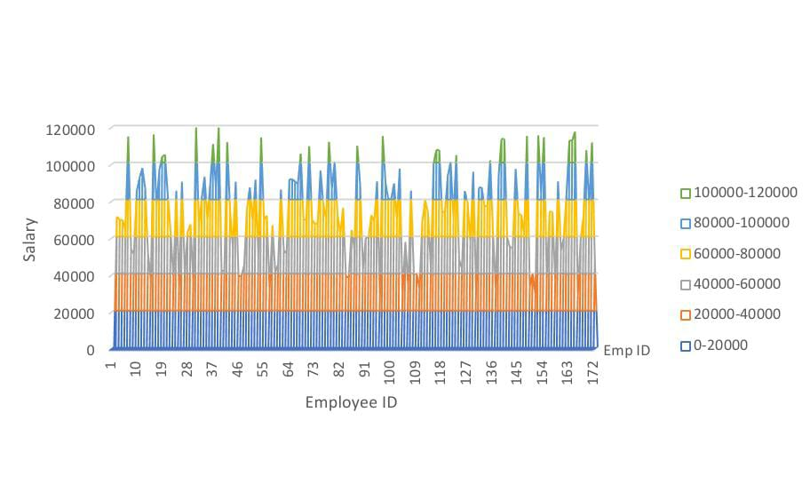
RESULT
‹#›

Slide 12
conclusion
In this project, I learned who to sort & filter the data, conditional formatting, pivot tables and how to insert charts.

